Slide 1
Neural Beer
Finding you the right option to damage your neurons.
Group 1: Brian, Ethan, Shey, and Arne

Slide 2
First things first, let’s go take a look.
Heroku App
Notes:
Shey – Show off functionality

Slide 3
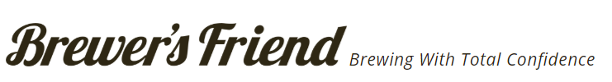
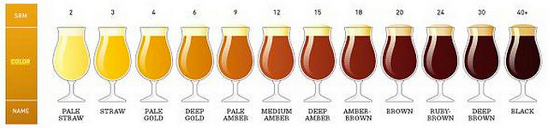
Data Source
75,000+ homebrewed beers with over 176 different styles [Link]
Set of recipe parameters input by users (homebrews)
Key parameters
ABV: Alcohol by volume
IBU: International Bitterness Unit, measured in parts per million of isohumulone
OG: Original gravity, Ratio of density compared to water, before fermentation
FG: Final Gravity – ratio f density compared to water, after fermentation
Color: See image to right
Unused params
Other scientific
Popularity (e.g., brews, views)

Slide 4
Objective (Watch out bartenders)
Use machine learning & neural networks to provide the following functionality to users:
Beer Recommender: Generate a list of beers they are likely to enjoy by submitting the name of a beer they have enjoyed in the past.
Assumption: People will tend to like beers with characteristics similar to those they have previously enjoyed.
Style Solver: Guess the style and category of a beer when a user inputs key parameters.
Assumption: Many homebrew fans will be able to identify (or estimate) these for beers they have purchased or brewed.
Style Trends: Show how the characteristics (ABV, IBU, and color) of homebrew beer styles have changed over time. (ABANDONED)
Notes:
Shey

Slide 5
Stack
}
}
Python Pandas
Numpy
SQLite
SQLAlchemy
Flask
Keras Neural Network: Categorical sequential model
Sci-Kit Learn: KMeans
PyMongo
Beautiful Soup
HTML
JavaScript
CSS
Data scrape
Munging
}
Front end
}
Routes
Notes:
Ethan

Slide 6
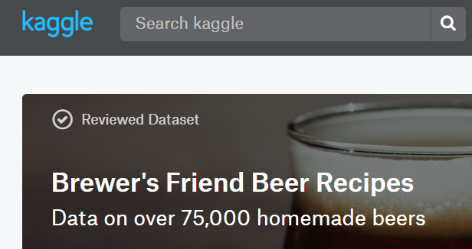
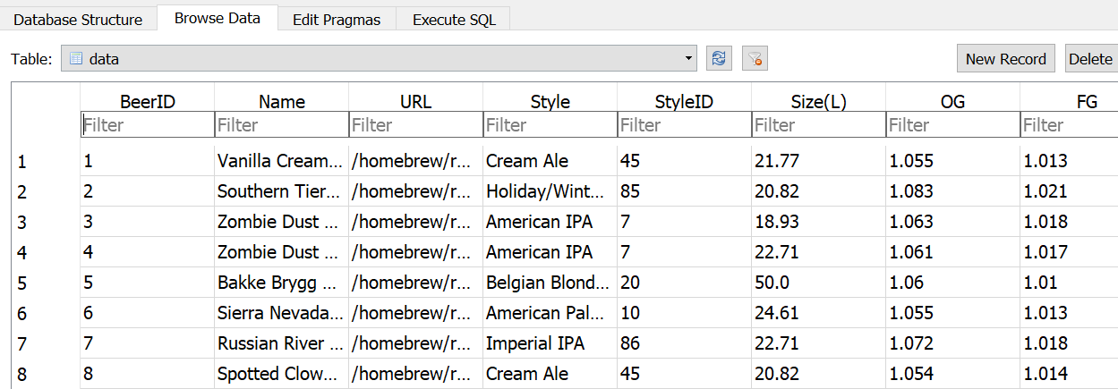
Data Collection & Munging
Download and import base dataset (CSV)
Scrape additional data from website
Clean and sort data
Create and populate SQLite database
Notes:
Ethan

Slide 7
Front End Setup
Prepare Flask app and routes
Setup HTML template & CSS
Develop JavaScript:
Style Solver - User input forms for ABV, IBU, and color
Recommendations – Cascading dropdowns: Select a style in first dropdown, populates beer list in second dropdown (PENDING)
All: Used AJAX library to fill in dropdowns dynamically; data pulled from created app routes
Notes:
Shey

Slide 8
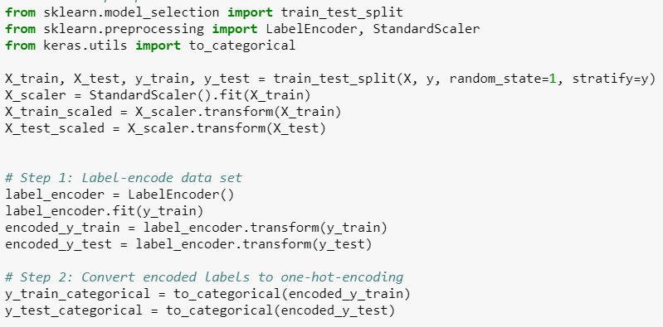
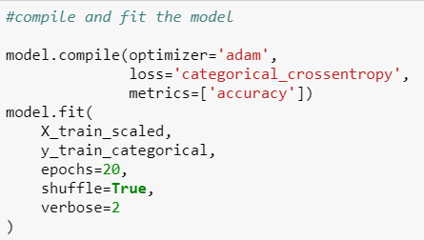
Style Solver: Sci-Kit Learn Keras Model (v1)
Load and preprocess data
Split data into Train & Test datasets
Scale
Implement one hot encoding
Compile & fit the model
Save, load, and predict
Result: 34% Accuracy. Needs work!
Notes:
Arne

Slide 9
Style Solver: Draft Model Troubleshooting
Problem: Poor accuracy, due to 176 output categories (w/ 5 params)
How we fixed it, Part 1: Neural network design.
Increased the number of neurons, hidden layers, and epochs.
Added 2 additional parameters (from 5 to 7)
Result: Increased to 47% accuracy. Still have a ways to go.
*This was the stage we abandoned the style trends.
Notes:
Arne, except Ethan picks up the reason that we abandoned (issues with accounting for Brews, Views with the given time parameters)

Slide 10
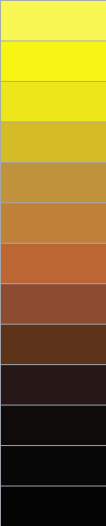
Style Solver: Draft Model Troubleshooting
How we fixed it, Part 2: Dimensionality reduction via 2 alternative
methods (i.e., reduce potential outputs):
Results : 4 separate models
Predict human intuitive categories: Models with 3 and 7 user inputs
Predict KMeans clusters: Models with 3 and 7 user inputs
Manual Consolidation of Styles
11 human intuitive categories (e.g., Stouts & Porters, IPAs & Pales)
KMeans Unsupervised Clustering
13 clusters. # selected based on Standard Reference Method, used by modern brewers to measure color intensity
Notes:
Arne

Slide 11
Model Results & Function – Human Intuitive
Manually created 11 “human intuitive categories” by visual scan
Examples: “Stouts and Porters”, “IPAs and Pale Ales”
Fit and tested a model to predict these categories (results shown later)
3 input parameters, various epochs
7 input parameters, various epochs
Expectations:
Lower prediction accuracy than KMeans
More meaningful output re: style names
Notes:
Arne

Slide 12
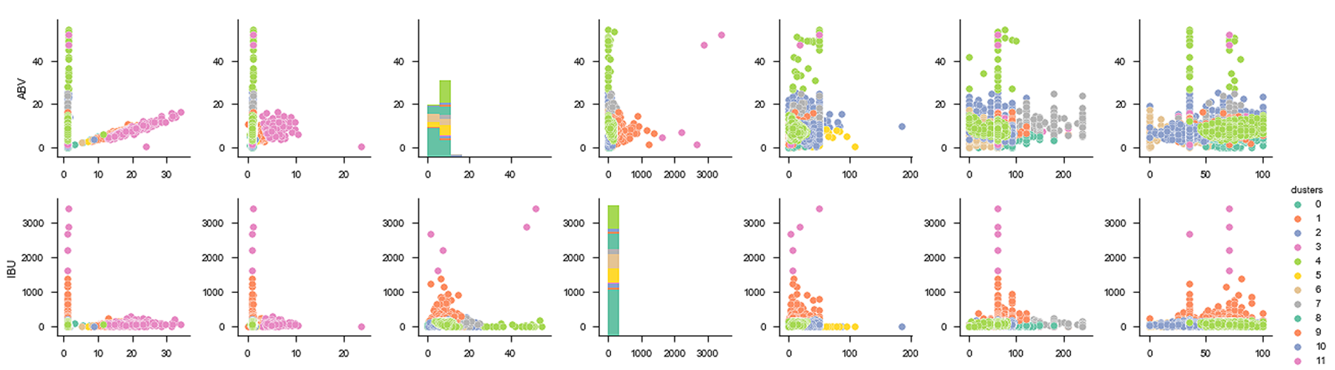
Model Results & Function – KMeans Cluster
Created 13 clusters (resulting clusters not “human intuitive”)
Prepared a scatterplot matrix to view relationships
Fit and tested a model to predict cluster
3 input parameters, various epochs
7 input parameters, various epochs
Expectations:
Higher prediction accuracy than human intuitive (useful for recommendations)
Less useful output for style predictor
Notes:
Brian

Slide 13
Model Results & Selection
Params | Outputs | Epochs | Accuracy
3 | 13 Kmeans clusters | 25 | .985
3 | 176 styles | 1,000 | .347
3 | 11 intuitive categories | 300 | .619
7 | 13 Kmeans clusters | 25 | .992
7 | 176 styles | 1,000 | .4767
7 | 11 intuitive categories | 300 | .690
Expectations generally matched reality
3 param intuitive model selected for Style Solver (users unlikely to know 7 params)
Chose to show Top 3 potential styles to address lower accuracy
7 param KMeans cluster model selected for Recommendations
Faced other issues along the way (e.g., overfitting)
Notes:
Brian

Slide 14
Back to the Product
App on Heroku
Notes:
All?

Slide 15
Obstacles/Challenges/Lessons Learned
What were our biggest challenges?
What did we learn?
What was the most fun?
What would we do differently next time?

